Slide 1
BRITISH AIRWAYS
PREDICTING CUSTOMER booking
by:
Ramana kulanthaivelu

Slide 2
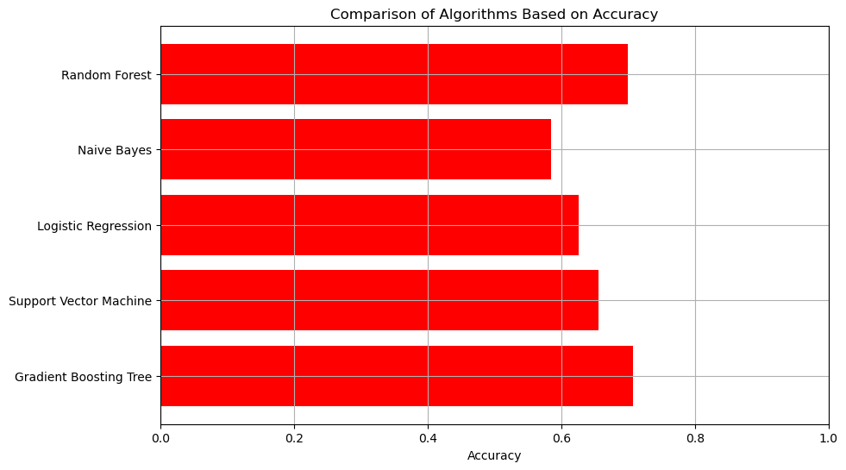
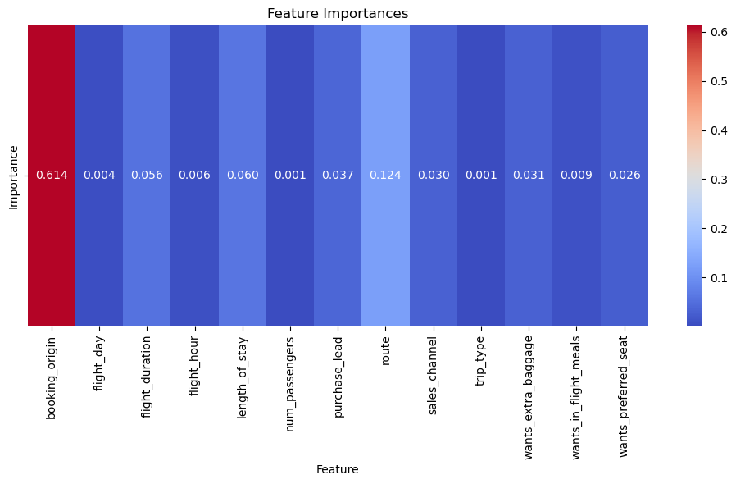
Results of the predicted models:
Best predictive model: Gradient boost Tree
Accuracy: 70%
Recall: 0.73
Precision: 0.68
F1 score: 0.70
The dataset found to be imbalanced and balanced
The Categorical values encoded and scaled
Model fitted

